Slide 1

PROFILING
Sheik Fareeth H : sheikfareet.heera@aspiresystems.biz
Gokul P : gokul.prathaban@aspiresystems.biz
Deepika S : deepika.senthil@aspiresystems.biz
Vinoth J : vinoth.jayakumar@aspiresystems.biz
Prithviraj SP : prithviraj.palanisamy@aspiresystems.biz
Aravindhan Ra : aravind.rangaraj@aspiresystems.biz
Remuki J S : remuki.soundar@aspiresystems.biz
Kumaresh K S: kumareshk.suresh@aspiresystems.biz
Vishnu Prakaash R : vishnu.ravi@aspiresystems.biz
Darshana A: darshana.annappan@aspiresystems.biz

Slide 2
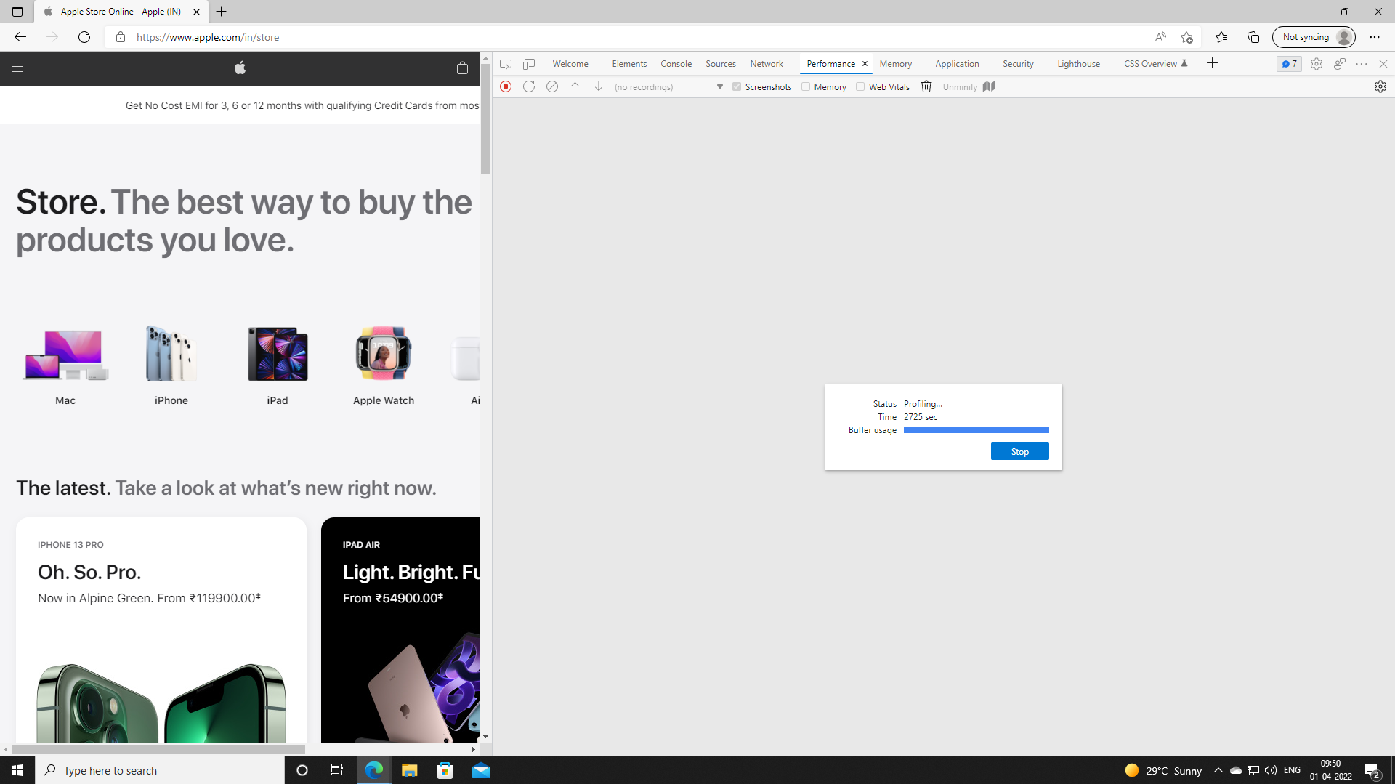
Profiling
Notes:
This slide is only for the trainer… You can display the poll from GTM and after the poll is taken, share the result, connect the poll result with the topic. Once done, you can hide the poll so that the PPT is visible.
I have created the poll in the GTM webinar.

Slide 3
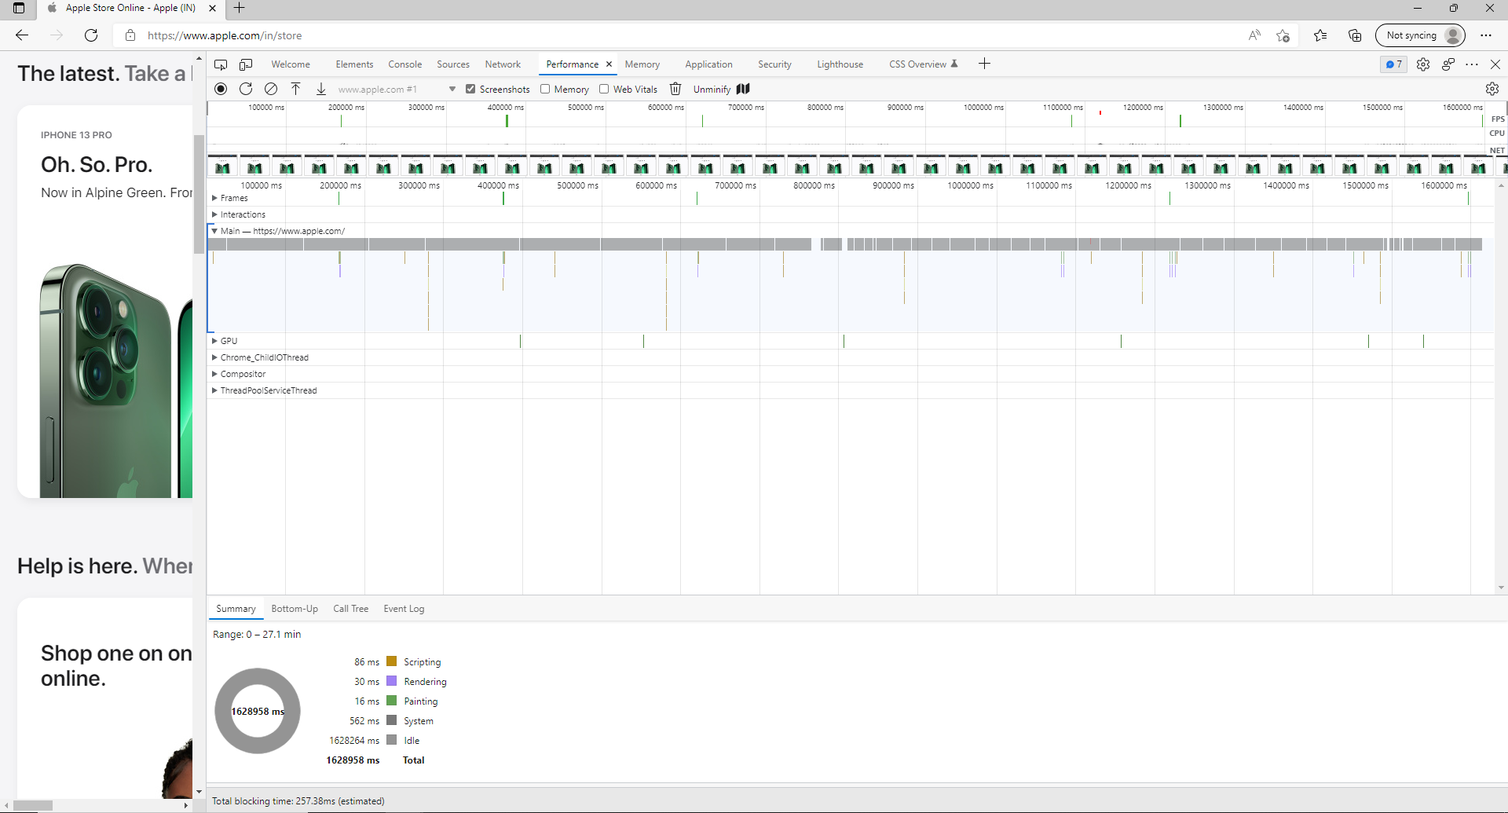
Performance
Notes:
This slide is only for the trainer… You can display the poll from GTM and after the poll is taken, share the result, connect the poll result with the topic. Once done, you can hide the poll so that the PPT is visible.
I have created the poll in the GTM webinar.

Slide 4
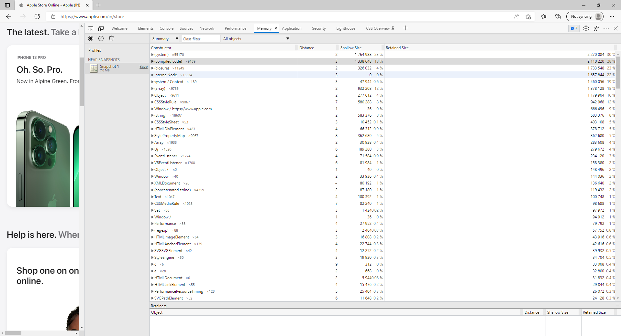
Memory
Notes:
This slide is only for the trainer… You can display the poll from GTM and after the poll is taken, share the result, connect the poll result with the topic. Once done, you can hide the poll so that the PPT is visible.
I have created the poll in the GTM webinar.

Slide 5
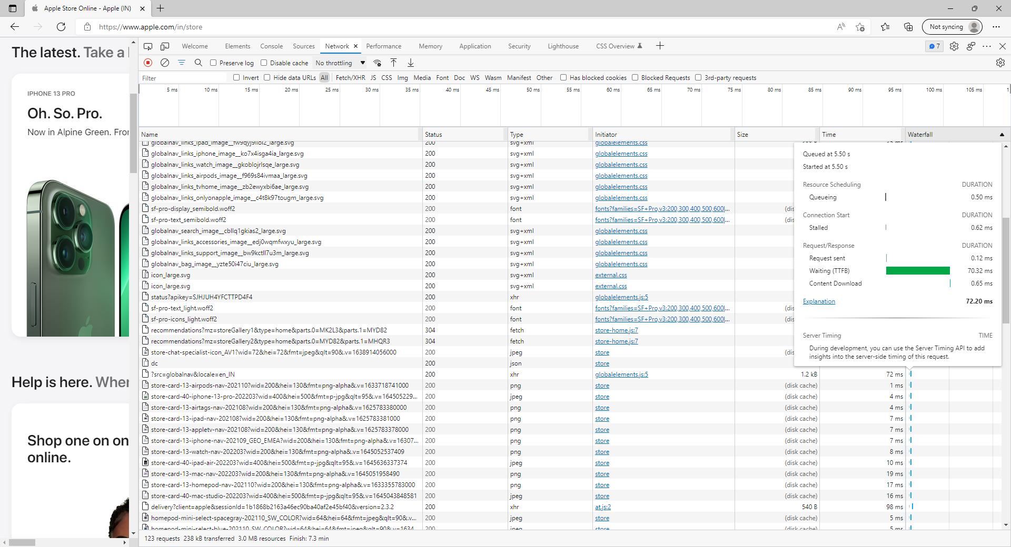
Network
Notes:
This slide is only for the trainer… You can display the poll from GTM and after the poll is taken, share the result, connect the poll result with the topic. Once done, you can hide the poll so that the PPT is visible.
I have created the poll in the GTM webinar.

Slide 6
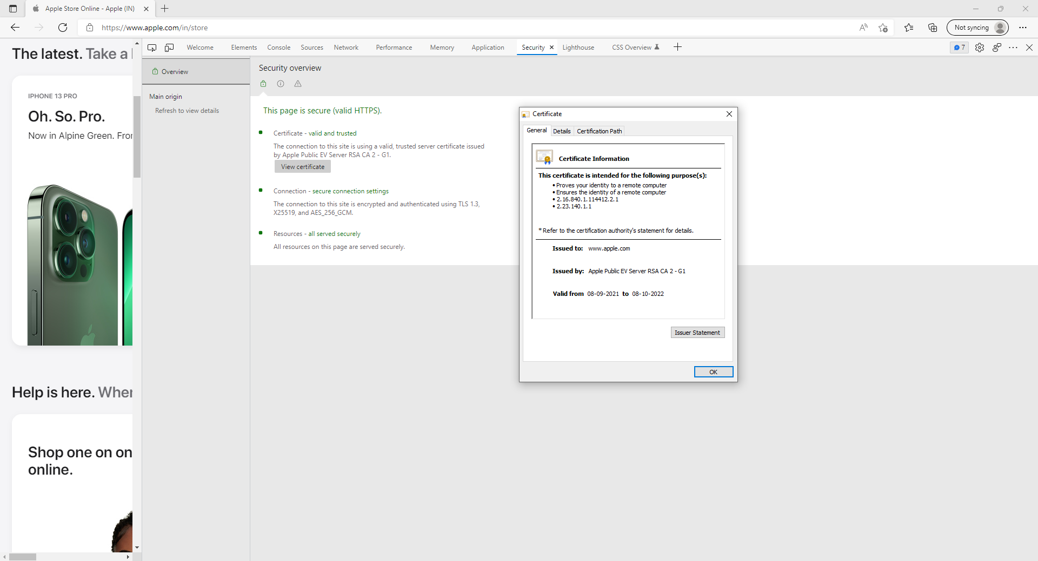
Security
Notes:
This slide is only for the trainer… You can display the poll from GTM and after the poll is taken, share the result, connect the poll result with the topic. Once done, you can hide the poll so that the PPT is visible.
I have created the poll in the GTM webinar.

Slide 7


